Slide 1
Hunger Knows No Boundaries
Notes:
Welcome audience
Introduce Yourself

Slide 2
The Stark Reality:
1 in 11 people struggle with hunger and miss an estimated 44 million meals every year.
1 in 8 children struggle with hunger.
61 percent of households who need food have at least one person who has worked in the last year.
70 percent of households served have incomes of $25,000 or less.
108 billion pounds of food are wasted each year.
Notes:
Nearly 3.5 million times each year, Harvesters’ network of pantry partners provides food assistance to someone in our region who is food insecure.
What does being “food insecure” mean? It means that someone does not have consistent access to healthy food because they either don’t have enough money or they have to decide whether to buy food or pay their utilities or rent or pay for their medicine.
So, what does a hungry person look like? Those who are food insecure are usually not homeless. They are all ages and races.
A couple of key facts -- one in 11 people, or more than 252,000 people in our region, is food insecure and missing an estimated 44 million meals annually. One in 8 children struggle with hunger.
And there is a lot of food waste – approximately 108 billion pounds each year.
This is why Harvesters is here.

Slide 3
Food Waste
Up to 40% of food goes to waste – that breaks down to 108 billion pounds of safe, wholesome food wasted every year.
All that food isn’t coming from household waste. 66 billion pounds is wasted by manufacturers, grocery stores and restaurants.
24% of landfill volume is food waste. When food is disposed in a landfill it rots and becomes a significant source of methane - a potent greenhouse gas with 21 times the global warming potential of carbon dioxide.
If we would reduce our food waste by just 20%, we could avoid 18 million tons of greenhouse gas emissions.
Notes:
With an estimated 108 billion pounds of food waste in the US each year, we must work together to capture more of this valuable resource for the nearly 34 million people in the United States who feel the effects of food insecurity.
An estimated 40 percent of food grown, processed and transported in the United States will never be consumed.
In fact, 24 percent of landfill volume is food waste. When food is disposed in a landfill it rots and becomes a significant source of methane which is a potent greenhouse gas with 21 times the global warming potential of carbon dioxide.

Slide 4
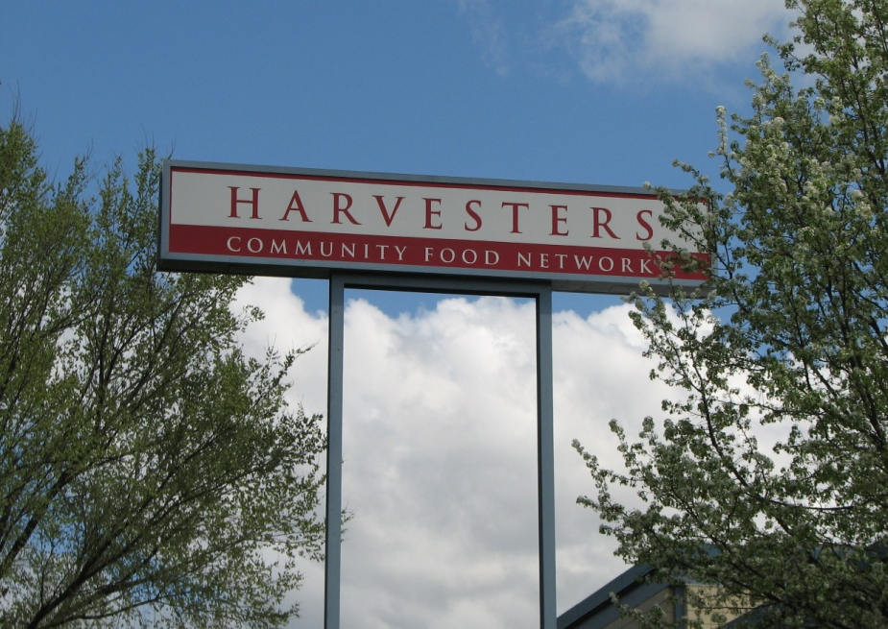
Who We Are:
Harvesters was founded in Kansas City in 1979. During its first eight months in operation, the new food bank distributed 155,000 pounds of food. Today, Harvesters distributes more than 63 million pounds of food annually.
Notes:
Harvesters was founded in Kansas City in 1979.
A group of people representing the faith community, social service agencies and the food industry met to discuss a problem.
While some were struggling to feed hungry people, tons of salvageable foods were being sent to landfills.
From that meeting, Harvesters was born.
During its first eight months in operation, the new food bank distributed 155,000 pounds of food.
Last year, we distributed more than 63 million pounds of food.

Slide 5
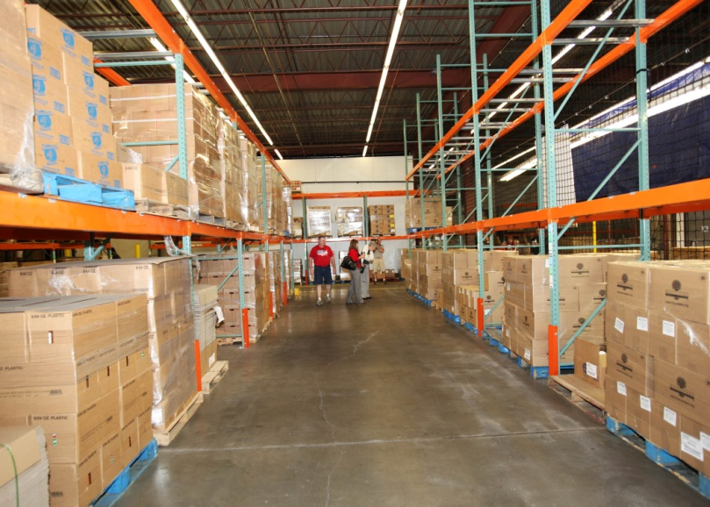
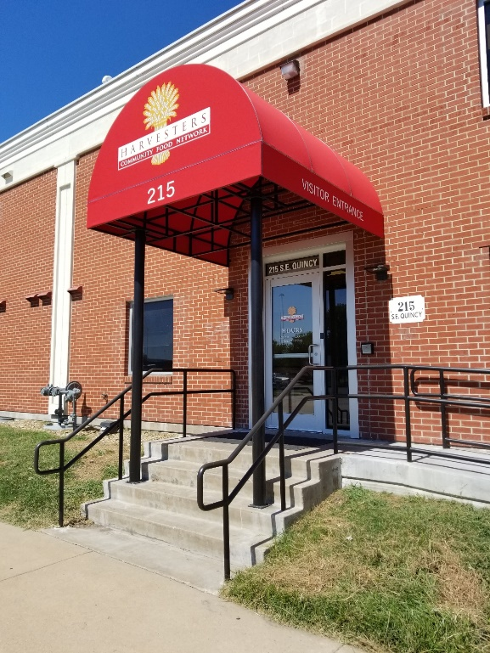
Who We Are:
The Kansas Distribution Center in Topeka opened in October 2010 to strengthen services and increase the amount of food available to partner agencies in northeastern Kansas.
Notes:
In October 2010, Harvesters opened its second distribution center at 215 Southeast Quincy Street in Topeka, Kansas. The new facility helps the food bank strengthen services and increase the amount of food available to partner agencies in northeastern Kansas.
A much-needed highway enhancement to I-70 and the Polk-Quincy Viduct is good news for drivers but will unfortunately impact our facility in Topeka. The project requires the demolition of our building.
We searched long and hard for a new location in Topeka but could not find one to meet our specific needs and was cost-effective.
So, we’ll be moving to a renovated site in Lawrence, Kansas with plans to open that facility in summer of 2024.
Our service to neighbors in Topeka and throughout northeast Kansas will NOT change. We’ll be distributing to the same 16 counties and same agency partners we always have.

Slide 6
Who We Are:
Harvesters is a member of Feeding America®, a nationwide network of more than 200 food banks.
In 2011, Harvesters was Feeding America’s Food Bank of the Year.
Notes:
Harvesters is a certified member of Feeding America, a nationwide network of more than 200 food banks. In 2011 Harvesters was Feeding America’s Food Bank of the Year.
Feeding America’s mission is to feed America’s hungry through its nationwide network of member food banks and engage our country in the fight to end hunger.
For more than 40 years, Feeding America has responded to the hunger crisis in America and today, Feeding America is the nation’s largest domestic hunger-relief organization.
As food insecurity rates remain very high, the Feeding America network of food banks has risen to meet the need. All of the food banks working together help feed millions of people at risk of hunger.

Slide 7
Who We Are:
Mission
Harvesters mobilizes the power of our community to create equitable access to nutritious food and address the root causes and impact of hunger.
Vision
A healthy thriving community where no one is hungry.
Notes:
Harvesters’ mobilizes the power of our community to create equitable access to nutritious food and address the root causes and impact of hunger.

Slide 8
Who We Serve:
Notes:
We are a regional food bank serving a 26-county area in northwestern Missouri and northeastern Kansas.

Slide 9
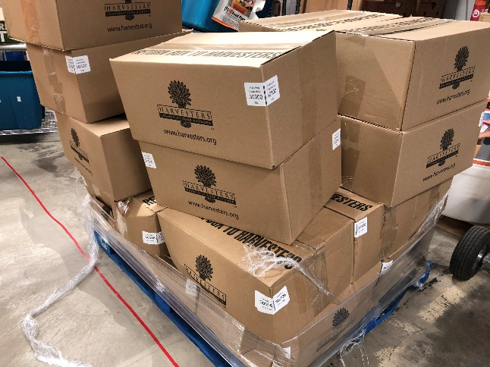
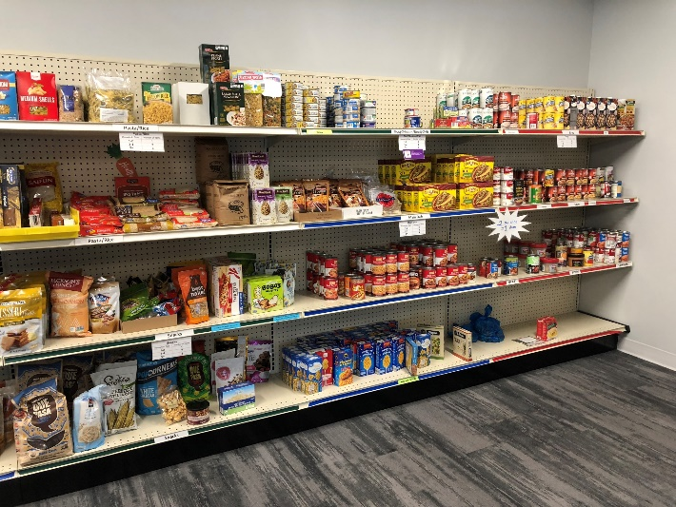
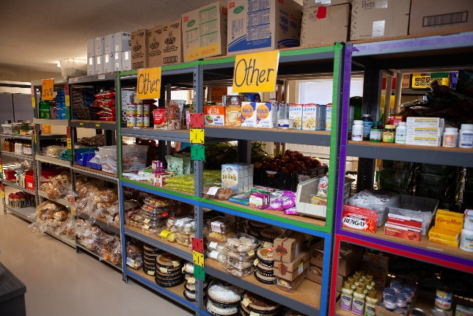
Who We Serve:
Harvesters provides food to more than 760 nonprofit agencies in 26 counties:
10 northwestern Missouri counties
16 northeastern Kansas counties.
Agencies include:
Pantries
Shelters
Kitchens
Notes:
Harvesters provides food and related household products to more than 760 nonprofit agencies including emergency food pantries, community kitchens, homeless shelters, children’s homes and others. We also offer education programs to increase community awareness of hunger and teach about good nutrition.

Slide 10
What We Do:
Harvesters is a food bank. A food bank acquires, stores and distributes food to its network of nonprofit agencies.
Total warehouse capacity in Kansas City is 231,796 square feet; total warehouse capacity in Topeka is 41,232 square feet.
Notes:
Harvesters is often confused with a food pantry.
As a food bank, Harvesters acquires, stores and distributes food to its network of nonprofit agencies, enabling them to do what they do best – providing direct service to families, children and seniors in need.
The total warehouse capacity in KC is 231,795 square feet. The total warehouse capacity in Topeka is 41,232 square feet.
Food comes in Monday through Friday and leaves our warehouse every day except Sunday.
Our total food stock turns over more than 14 times a year – that’s about every three weeks our warehouse could be empty if we didn’t have food constantly coming in.

Slide 11
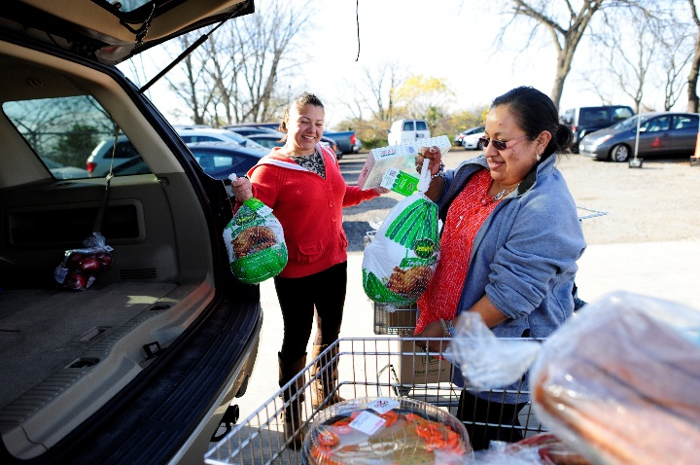
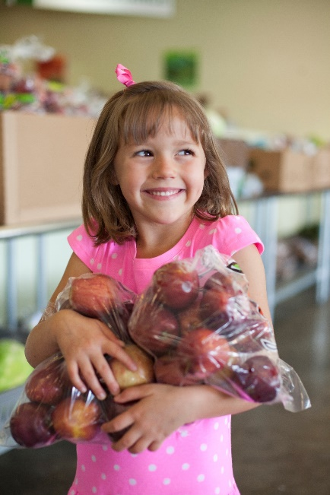
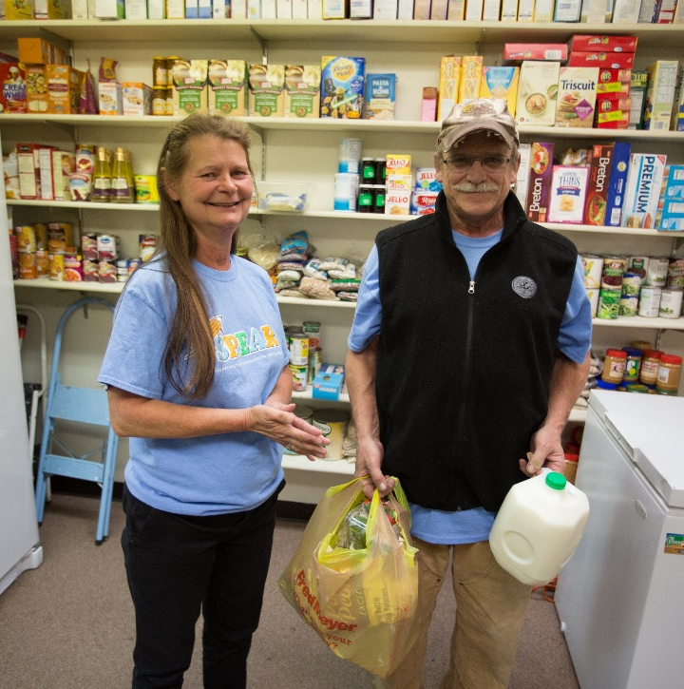
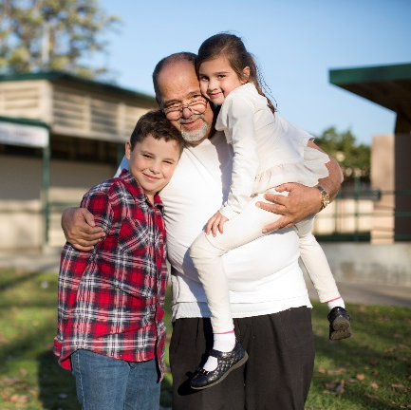
What We Do:
Major Initiatives:
Feeding Children
Feeding Seniors
Feeding Families
Promoting Healthy Eating
Notes:
Harvesters has four major initiatives:
Feeding children
Feeding seniors
Feeding families
And Promoting healthy eating

Slide 12
Feeding Children:
1 in 8 children are food insecure.
56 percent live in households not eligible for federal nutrition programs.
Children who are not hungry:
Have higher grades.
Less tardiness/absenteeism and misbehaviors.
Notes:
Data shows higher grades, lower incidents of tardiness/ absenteeism and misbehavior when children are not hungry.
We provide 7,000 BackSnacks to kids every weekend and partner with more than 60 schools on school pantries.

Slide 13
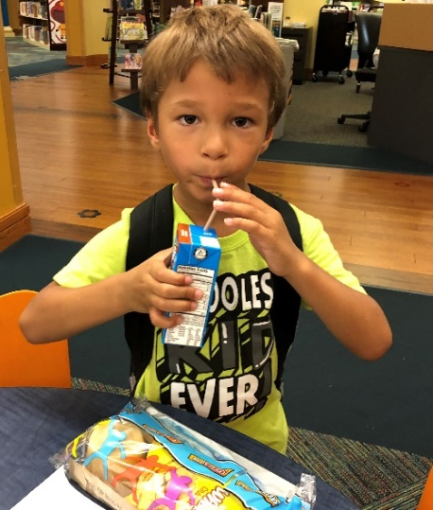
Feeding Children:
BackSnacks:
4 meals and 2 snacks each weekend.
Cost: $250/child.
Schools determine which students need BackSnacks.
School Pantry:
The School Pantry program is a food pantry conveniently located on-site at schools for families of students in need.
Last fiscal year, there were 60 school pantries.
Notes:
BackSnack is a key example of how we help kids that are food insecure. BackSnack provides backpacks of food to elementary and middle school children to combat weekend hunger (4 meals, 2 snacks). All food is purchased by Harvesters and packs are assembled by volunteers. The cost for 1 BackSnack per child for the school year is $250. BackSnacks are shipped to schools, who work with community partners to clean and refill backpacks every week. The schools determine which students are in need.
We provide training to schools, and we collect data from schools, students and parents.
The School Pantry program is a food pantry that is conveniently located on-site at schools for families of students in need. The school pantries complement school breakfast and lunch programs, providing access to food for children and their families after the school day has ended. They help to fill an important gap, relieving the burden and anxiety a family may face when they aren’t sure where their next meal may come from. And they help children to focus on their education, not hunger.

Slide 14
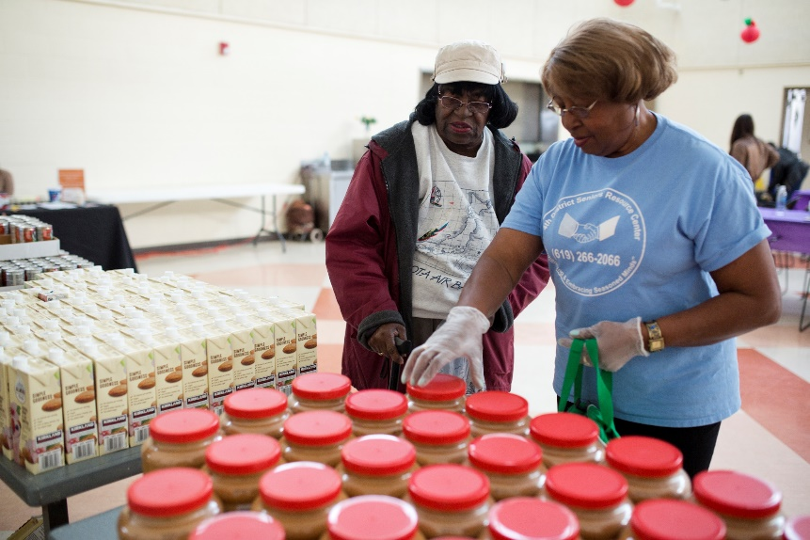
Feeding Seniors:
15 percent of who we serve are over 55 years old.
Seniors receive assistance through Senior Mobile Food pantries.
Many agencies also distribute monthly commodity food boxes to low-income seniors.
Notes:
As Baby Boomers age, the need for food assistance by older adults is projected to increase. By 2040, studies project one in five U.S. residents will be older adults. Food insecure seniors are at higher risk for depression and chronic diseases. Many seniors in our community face health and mobility problems that limit their access to healthy food.
Seniors receive assistance through Senior Mobile Food Pantries. These pantries are a partnership between Harvesters and nonprofit organizations providing social services to at-risk seniors living in low- to moderate-income housing communities.
In addition, in partnership with the federal government, many of Harvesters' agencies distribute monthly commodity food boxes to low-income seniors through the Commodity Supplemental Food Program (CSFP). The boxes contain shelf-stable items like milk, fruit juices, pasta, rice, peanut butter, and canned meats, fruits and vegetables.

Slide 15
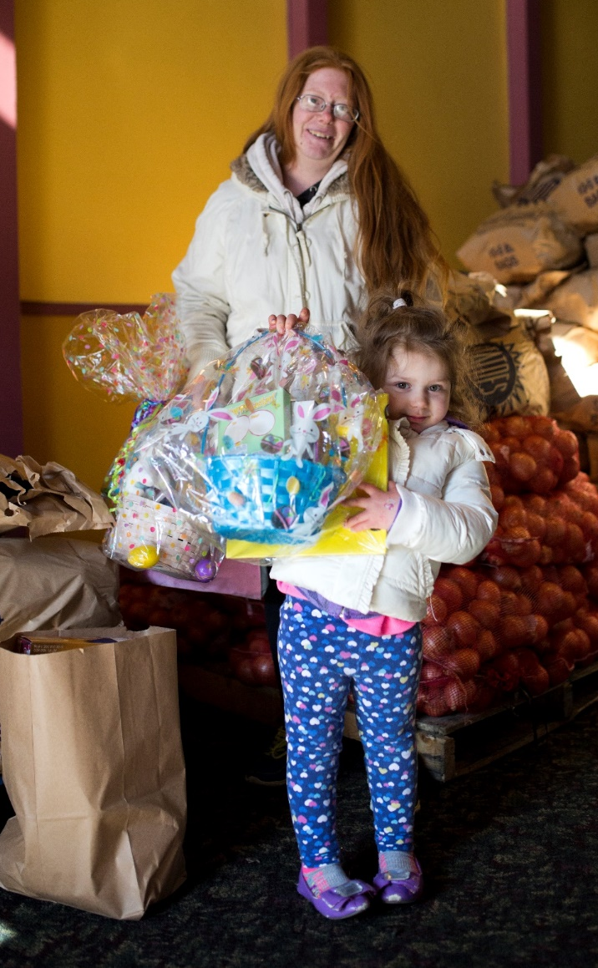
Feeding Families:
Harvesters’ network feeds many working families.
Under-employment and low household income are key factors in the high need for food assistance.
Many households relying on Harvesters’ agencies may face health challenges.
Notes:
While Harvesters’ network feeds many working families, under-employment and low household income are key factors in the high need for food assistance. In addition, households relying on Harvesters may face challenges related to health and well-being.

Slide 16
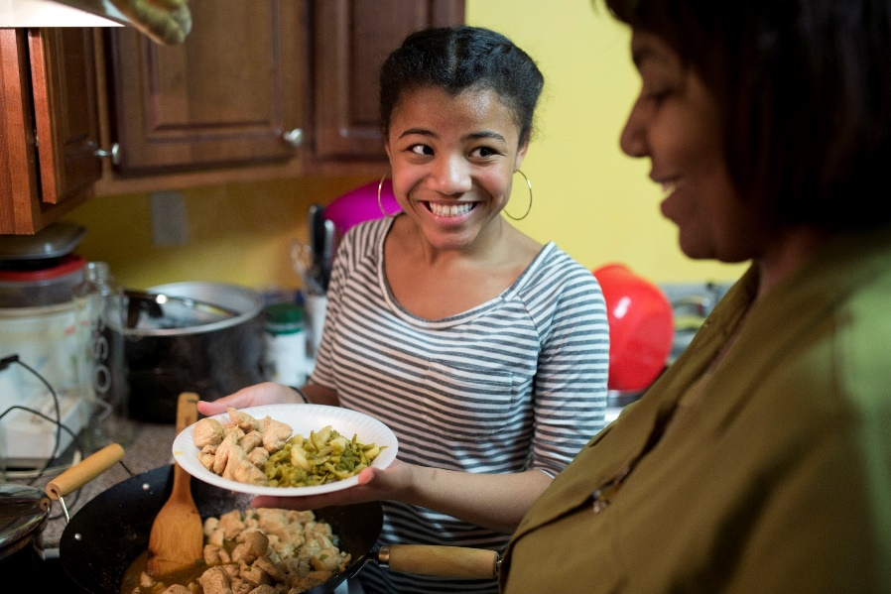
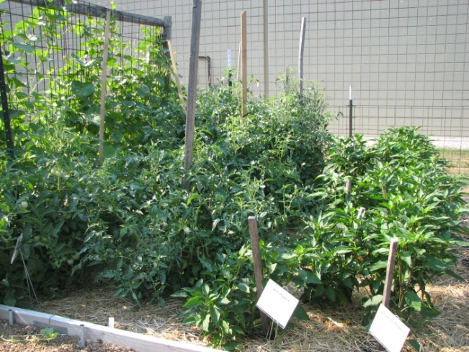
Promoting Healthy Eating:
Nutrition Services trains agencies to teach children, teens and adults about preparing healthy meals and snacks on a budget.
Nutrition Services also reaches out to clients at food pantries and mobile distributions providing recipes and tastings.
Notes:
Harvesters’ Nutrition Services Department trains agencies to teach kids, teens and adults about preparing healthy meals and snacks on a budget.
Nutrition Services also reaches out to clients at food pantries and mobile distributions – providing recipes & tastings to encourage healthy food selection and preparation.

Slide 17
Intersection of Hunger and Health
Hunger impacts health. Many of the people our network serves suffer from chronic health issues.
Harvesters is focusing on hunger and health by:
Providing healthier food options to our agencies.
Increasing distribution of fresh produce.
Partnering with health care organizations to feed people and improve health.
Notes:
Why is Harvesters focusing on the intersection of hunger and health?
In the past, food pantries focused on filling empty stomachs with whatever food was available. Much of this food tended to be highly processed and full of fat, sugar & sodium. Easily accessible, non-nutrient dense food may temporarily alleviate hunger pangs, but ultimately can contribute to chronic disease such as obesity, diabetes and heart disease.
If we are providing food, all the more reason to help agencies obtain the healthiest food. Especially when we remember that 55% are struggling with hypertension and 38% with Diabetes. Unhealthy food could exacerbate their chronic disease condition and increase their debt/food security/poverty. We are not saying no to certain foods, just understanding that it is easy for neighbors to acquire the less healthy foods and harder/more expensive to acquire the healthier foods. We are focusing on encouraging healthier foods.

Slide 18
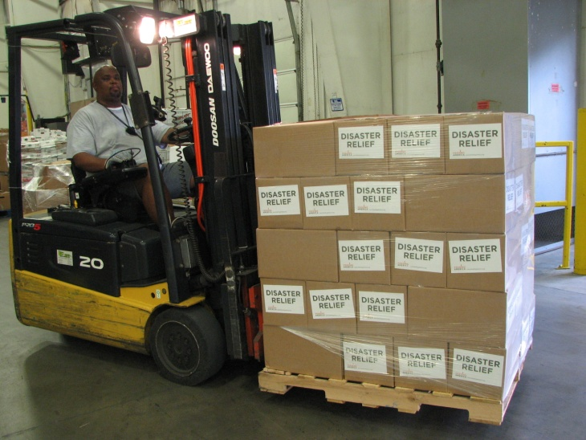
Disaster Relief:
Harvesters responds to natural disasters.
Feeding America coordinates with FEMA and state response to request support.
We provide disaster supplies, such as bottled water, cleaning supplies, and shelf-stable food to areas in need.
Notes:
We also respond to natural disasters and are part of a cohort with Feeding America food banks in Missouri, Kansas, Oklahoma, Arkansas, Iowa and Nebraska. We work together to help each other with food and other resources if a disaster strikes in this region.
We also respond to other parts of the country when needed.
Feeding America coordinates w/ FEMA & state response to request support.
Harvesters’ 53-foot disaster response trailer and smaller refrigerated trailers that can be sent to areas impacted by disasters.
We provide disaster supplies, such as bottled water, cleaning supplies, and shelf-stable food to areas in need.
As an example, Harvesters transported more than 250,000 pounds of food to Joplin after the tornado to feed tornado survivors, first responders and disaster relief volunteers.

Slide 19
Demonstration Garden:
Harvesters’ garden shows affordable ways to grow healthy produce in any setting.
Beds made from recycled materials.
Member agencies can pick up produce from the garden when picking up orders.
Notes:
Developing long-term solutions to hunger is a vital part of Harvesters’ mission. That’s why the food bank partnered with Kansas City Community Gardens and Master Gardeners of Greater Kansas City to develop a demonstration garden.
Community gardens bring neighbors together and empowers people to supplement their food supply by growing it themselves. According to the USDA, one 10-foot by 20-foot garden plot can provide as much as $600 in produce in one year alone.
Community gardens can be built and maintained by groups of neighbors, members of agencies, faith-based groups or schools. Yet individuals can adapt many of these principles for personal use –something agencies to pass on to their clients.
Harvesters’ garden, supported by the Master Gardeners of Greater Kansas City, demonstrates affordable ways to grow healthy produce in virtually any setting. The beds are made from recycled materials, organic waste is composted and the featured fruits and vegetables grow well in Kansas City’s climate.
Member agencies can take advantage of the garden when picking up orders or browsing the shopping floor. Located on the north side of building, the garden shows just how creative planting can be by using old tires and laundry baskets to pot plants.

Slide 20
Where the Food Comes From:
In FY23, we acquired 67.5 million pounds of food from:
Local Sources
Feeding America
Gov’t. Sources
Purchased by Harvesters
Notes:
In FY23, we acquired more than 67 million pounds of food from:
Local Sources including grocery stores, wholesalers (like AWG), producers (like the MO apple growers), manufacturers (like American Italian Pasta, C&C Produce).
Feeding America. One of the benefits of being in a network of more than 200 food banks is equitable access to national food donations and campaigns.
Purchased by Harvesters. Harvesters also purchases food, including all the food in the BackSnacks program.
USDA. We distribute more than 4,000 boxes of commodities (CSFP) to qualifying senior citizens each month and we distribute 5.5 million pounds of emergency food assistance (TEFAP) to qualifying households.
Food Drives. Often the first touch for many with Harvesters is participating in a food drive. Food drives help fill the needs for most nutritious or needed items. A small slice but an important component is the Virtual Food Drive, since every $1 donated = 2 meals acquired.
Other Food Banks. We work together to meet the need by exchanging surplus-to-need donations.

Slide 21
Where the Food Goes:
Harvesters distributes the acquired food to:
Pantries
Kitchens
Shelters
Youth Meal Programs
Other Feeding Programs
Notes:
Last FY we distributed more than 63 million pounds of food
Our agency network and programs operate in a geographically diverse area. These include:
Pantries – including brick & mortar facilities, or mobile distributions where a Harvesters truck pulls into a parking lot and unloads pallets of food which the agency then distributes to its clients.
Kitchens which prepare and serve an on-site meal.
Shelters which prepare and serve meals in short-term or residential facilities .
In November and December, we distribute Holiday Meats to agencies. This includes turkeys and chickens.

Slide 22
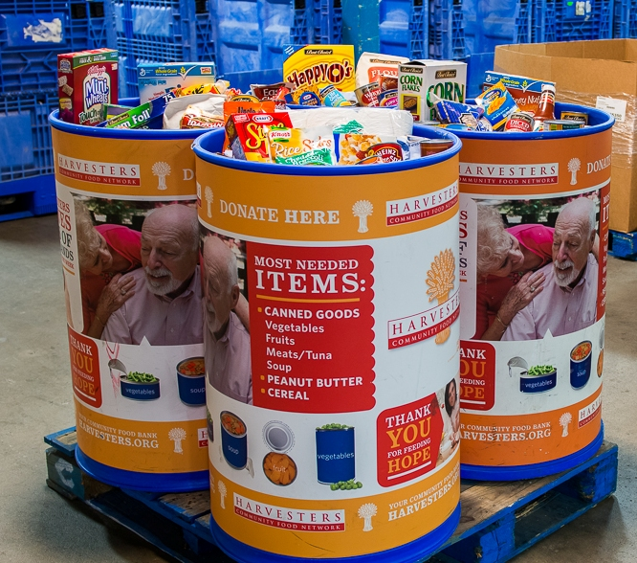
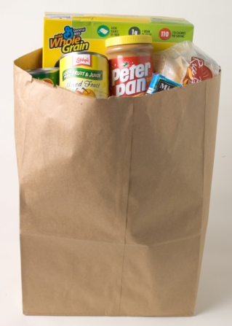
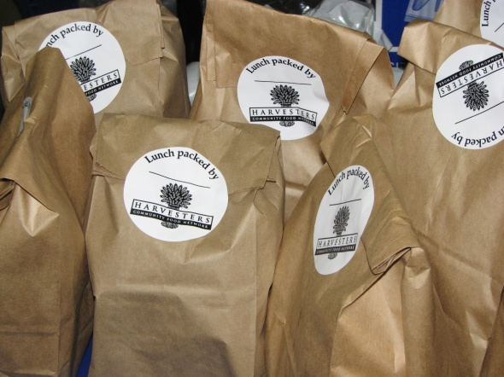
How You Can Help:
Give Food
Food Drives
Virtual Food Drives
Notes:
There are many ways that families, organizations, faith-based groups and companies can make a difference by donating food to Harvesters. Hold a food and fund drive Sponsor a food and fund drive for Harvesters at your workplace, school, place of worship, neighborhood or civic organization.
Hold a Virtual Food Drive Expand your drive and make it mobile by hosting a fun, online Virtual Food Drive.
Donate food today Donate food at our Kansas City or Topeka facilities during normal business hours. Look for our blue donation barrels in area grocery stores.
Meal Kits Collect or purchase all the items needed to make one meal. You can make one box or dozens of boxes. This is a great activity for a corporate or community group.

Slide 23
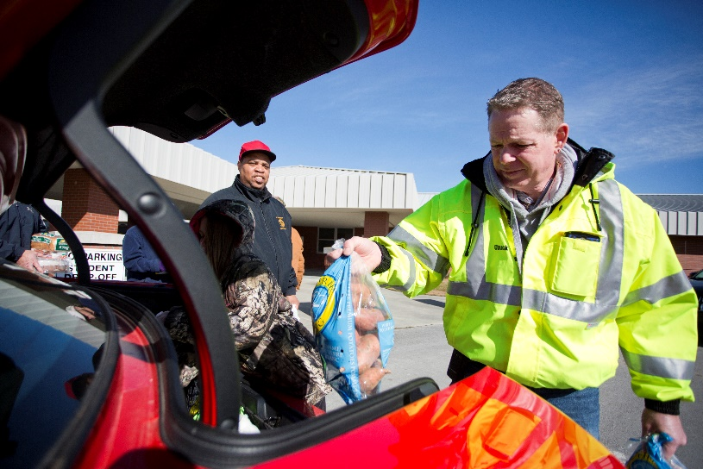
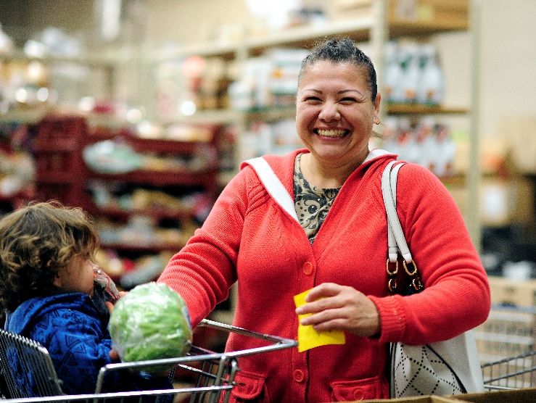
How You Can Help:
Give Money
For every dollar donated, you can help Harvesters provide two meals.
Notes:
Your financial donation helps us feed hungry people today and work to end hunger tomorrow. For every dollar donated, Harvesters is able to provide two meals to hungry seniors, families, and children in our community.

Slide 24
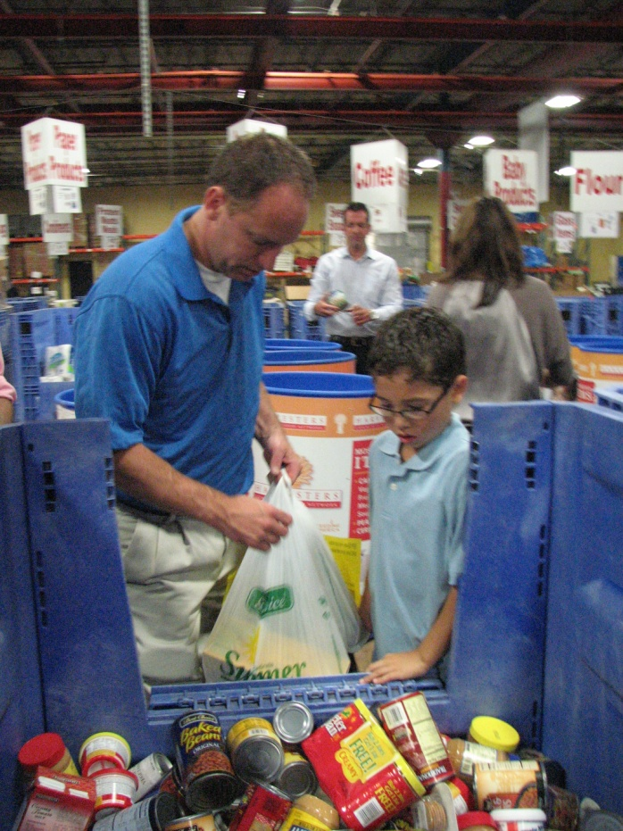
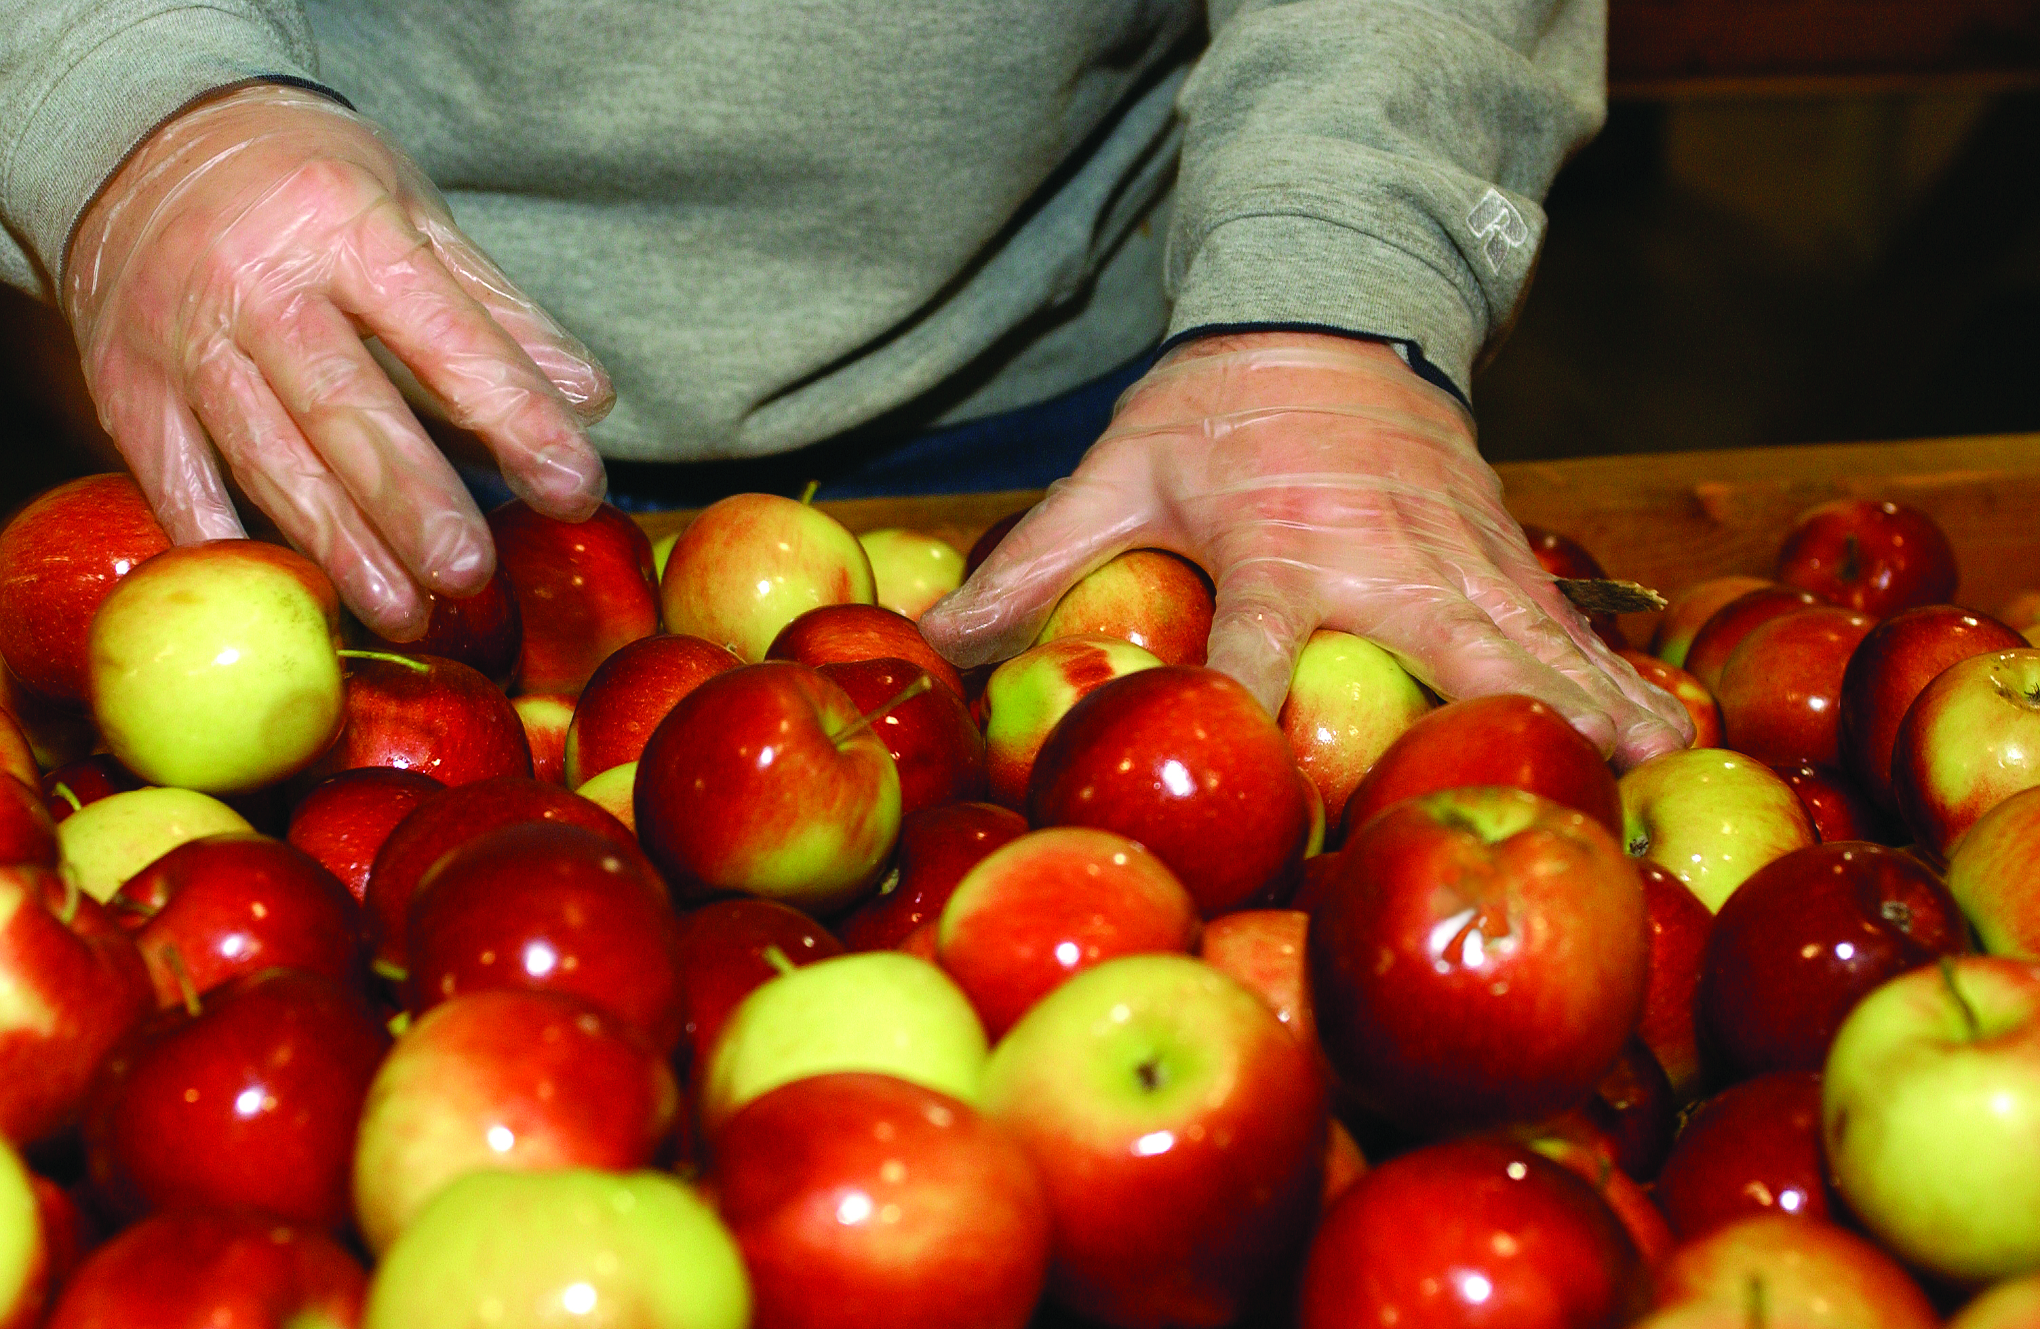
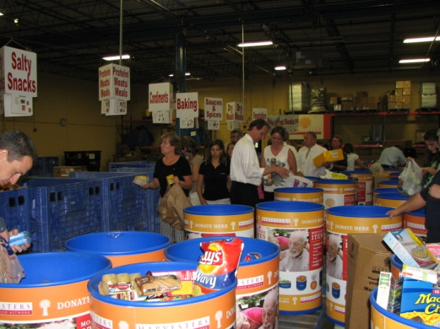
How You Can Help:
Give Time
Volunteer
Notes:
Harvesters is so grateful for the work of our volunteers, who bring their hearts and hands to the job of feeding hungry people! Our network could not feed more than 200,000 people every month without the dedication and service of our volunteers. Hours spent sorting food, assisting at special events or providing professional service equate to the work of an additional 64 full-time employees!
To volunteer, go to Harvesters’ website at harvesters.org and click on the “give time” button to see the volunteer opportunities in both Kansas City and Topeka.

Slide 25
How You Can Help:
Stay connected -
harvesters.org
Notes:
Thank you! Please join us in the fight to end hunger.

Slide 26
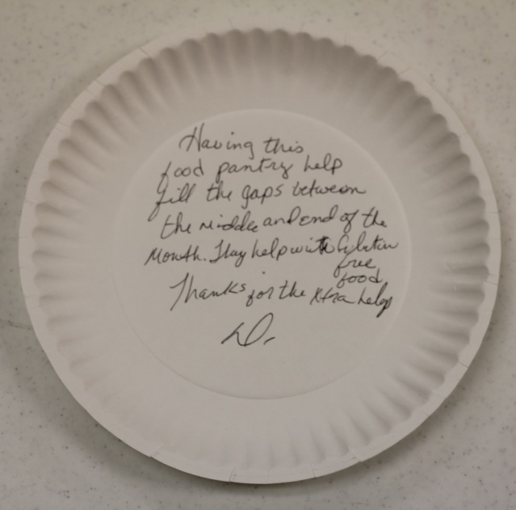
How You Can Help:
Give Voice
Be an advocate for hunger relief
Sign up for Harvesters’ Advocacy News Briefs
Notes:
YOU have the power to help end hunger! Here's what you can do to give voice to hunger and make a difference.
Follow us on Facebook, X, LinkedIn, and Instagram. Share our posts on hunger facts and Harvesters’ news with your friends and followers.
Sign up for Harvesters’ advocacy email alerts through the “give voice” button on Harvesters’ website. You’ll receive information on proposed changes in state and federal nutrition assistance programs.
Share your support for hunger relief. Let your elected officials know you support comprehensive anti-hunger initiatives and legislation. Go to Harvesters website to get information about how to contact your U.S. Senator or Representative.

