Slide 1
Welcome to
The Lunch Challenge!
Notes:
Welcome and Introductions (Slide #1)
Welcome to “The Lunch Challenge.” Thank you for coming and spending part of you day at Harvesters. My name is --------------------- and I will be your facilitator today.”
Describe your role with Harvesters.
Introduce Judges, Harvesters Staff/AmeriCorps helping, etc.
Have teams introduce themselves (locations, number of employees, what they do and why they are here).

Slide 2

The Lunch Challenge Objectives
Better understanding of food insecurity
Prepare a meal facing the daily challenges of SNAP recipients
Experience teamwork and have fun!
Notes:
Lunch Challenge Objectives
We hope that as a result of our time together you will…
Develop a greater awareness of hunger issues
Prepare a great meal under the constraints facing SNAP recipients.
Demonstrate collaboration and problem solving
HAVE FUN

Slide 3
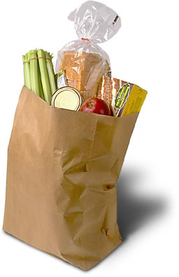
The Lunch Challenge Agenda
Understanding Food Insecurity
Orientation
Plan and Prepare Meal
Presentation to Judges
Enjoy Lunch
Awards
Wrap-up

Slide 4
Daily Challenges
Food insecurity
  Where will my next meal come from?
Food deserts
  Limited access to full service grocery stores
Consequences
  High stress levels, mental and physical health complications, inability to focus, etc.
    .
Notes:
Nutrition challenges for families we serve
Food insecurity
not knowing where your next meal is coming from, erratic meal patterns. In our 26 county area, one in eight adults and one in six children or over 320,000 people is food insecure and missing an estimated 60.3M meals annually. The 320K represents 13.3% of the population in our 26 county service area. The national average is 12.5%. That means that they have a meal today but do not know if there will be food for tomorrow. Of the over 320K people, 100K are children. That’s 17% of all children 18 and younger (same as the national average). 38% of these kids live in a household that DOES NOT qualify for SNAP and often must rely on charitable food assistance programs.
Food deserts
Lack of access to full service grocery. Occurs in the inner-city and rural areas mainly where you can’t walk or easily drive to a convenient full service grocery store. I live in --------- and have the opportunity/luxury to drive 1.2 mile to 3 different grocery stores. Those in the inner-city and many rural communities do not have this opportunity and must rely on buses or someone else to take them to a full service grocery store or stores such as 7-11 or QT where the selections are limited and the prices high. If you had to walk to the sore, how far would you need to go and how much could you carry home?
Might also want to talk about time constraints – Many people today don’t have the luxury of making a grocery list and planning time for grocery shopping so they run each night to the nearest store for dinner and essentials. Or there job only allows them to shop in the early morning when not all grocery stores are open so options are limited.
Consequences:
Stressful life circumstances, impacts energy, mental health, general health, children learning and growing, etc.
Consider the impact on dignity and self confidence.

Slide 5
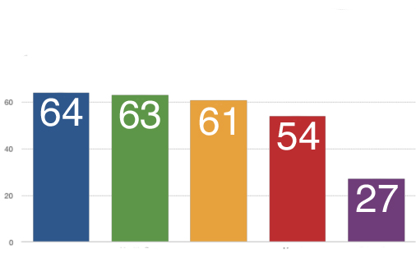
Tough Choices
Percent of households choosing between food and…
Utilities
Health Care
Trans-portation
Housing
Education
Notes:
Utilities – example of propane costs in rural areas
Health – Buy medicine or take kids to doctor
Transportation – Buy insurance or take risk
Housing – If own, make repairs, i.e., broken toilet. If renting, pay higher rent or move to cheaper.
Education – How to get a better job if can’t afford to take classes, get GED or get certified.

Slide 6
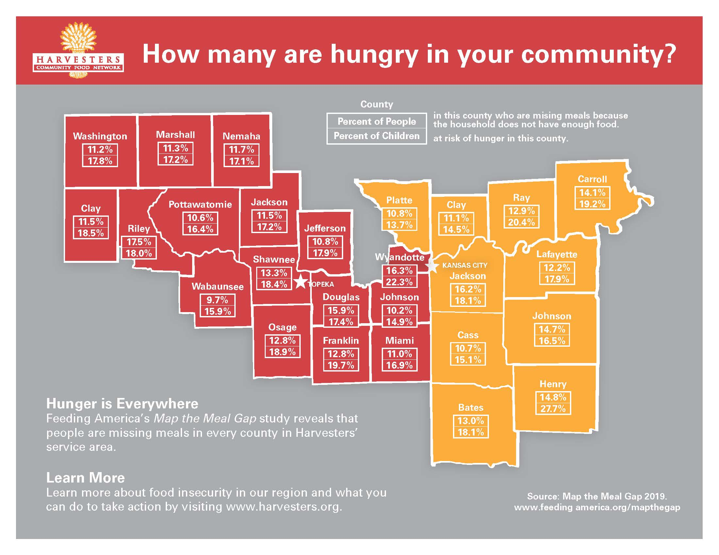
Notes:
Overall 1 in 8 adults and 1 in 6 children are food insecure in the 26 county area.
Kansas ranges from 9.7% in Wabaunsee to 17.5% in Riley County for all the population; however, when looking specifically @ children the highest % is in Wyandotte @ 22.3% (almost one in 4 children)!
Missouri ranges from 10.7% in Cass county to 16.2% in Jackson county. Specifically for children, the rate is 27.7% in Henry county over one in four.
In Johnson County, one of the Top 10 most affluent counties in the nation, the food insecure rate is 10.2% overall and 14.9% for children.

Slide 7
What is SNAP?
Supplemental Nutrition Assistance Program
The largest program in the domestic hunger safety net
Offers nutrition assistance to eligible low-income individuals and families
Provides economic benefits to communities
One in 14 working Kansans and one in 11 working Missourians receive SNAP benefits
Notes:
Applying for SNAP is a time consuming and daunting process in many states. For example, in KS the application is 19 pages!. Also there typically is a 30 day wait after the application is approved before the program will start.
How long will I receive SNAP?
If you are found eligible, you will receive a notice that tells you how long you will receive SNAP benefits; this is called your certification period. Before your certification period ends, you will receive another notice that says you must recertify to continue receiving benefits. Your local SNAP office will provide you with information about how to recertify. It’s important to note these notices are sent through the mail.
Overall, new participants spend an average of only 12 months on SNAP and most leave the program within 2 years. There is no “benefit cliff” with SNAP, because for every additional dollar a SNAP participant earns, their benefits decline by 30 cents – no a full dollar so there is a strong incentive to find a job, work longer hours or seek better paying employment.
More than half of SNAP households with at least one working age, non- disabled adult, work while on SNAP, more than 80% work in the year before or after receiving SNAP.
SNAP is an important support for people while they are between jobs and looking for work, it doesn’t keep them from looking for work.
Distribute handout for exercise.

Slide 8
SNAP Purchases
Eligible:
  Any food or food product for home consumption
  Seeds and plants which produce food for home consumption
What cannot be purchased:
  Alcoholic beverages
  Tobacco products
  Hot food and any food sold for on-premises consumption
  Non-food items such as pet food, soap, paper products, medicines and vitamins, household supplies, grooming/personal hygiene products and cosmetics.
Notes:
WHAT CAN BE PURCHASED WITH SNAP The Food and Nutrition Act of 2008 (the Act) defines eligible food as any food or food product for home consumption and also includes seeds and plants which produce food for consumption by SNAP households. The Act precludes the following items from being purchased with SNAP benefits: alcoholic beverages, tobacco products, hot food and any food sold for on-premises consumption. Nonfood items such as pet foods, soaps, paper products, medicines and vitamins, household supplies, grooming items, and cosmetics, also are ineligible for purchase with SNAP benefits.

Slide 9
Our Four Families
1. Blue Rapids, KS senior couple
2. Kansas City, MO couple with four children
3. Olathe, KS multi-generational family
4. Liberty, MO single mother of two children
Which of these families qualifies for SNAP benefits?
Notes:
I now would like to introduce you to our four families. These families are fictitious in nature but fairly represent the demographics of the 26 counties that Harvesters serves.
The handout has more information about each family. Each team to think about which of these families may qualify for SNAP benefits and the level of monthly benefit.

Slide 10
SNAP Benefits
$ 807
$ 270
$ 95
$ 0
Match the available SNAP benefits to each of our families
Notes:
As a side note, for a family of 4, recommended 2017 weekly food budget using the My Pyramid food intake and other guidelines developed by the USDA is as follows:
Moderate Budget = $241.80 ($1,050 per month)
Low Budget = $193.60 ($840 per month)
Thrifty = $147.30 ($640 per month).
The weekly budgets assume that all meals and snacks for a family of four are prepared at home.
How does your family’s weekly food spending compare (home cooked meals, take-out, restaurants).

Slide 11
SNAP Benefits
Match the available monthly SNAP benefit to each of our families
$ 807
$ 270
$ 95
$ 0
Olathe, KS multi-generational family
Liberty, MO single mother of two children
Blue Rapids, KS senior couple
Kansas City, MO couple with four children
Notes:
If you do the math for those who are eligible for SNAP benefits, you will note that it each person’s benefit is about $50 to $100 per month. Not a great deal of money when you are trying to prepare 3 nutritious meals per day.
How does your family’s weekly spend compare??
===================
There are many considerations/requirements to be met in order to be eligible for SNAP Benefits: Some of these include:
Household size
Household resources, i.e., cash. bank balance
Vehicles, valued over $4650
Income limits based on household size
Shelter costs
Work eligibility and requirements
US citizenship
The facilitator might mention a few or all of the items but not go into detail. Participants can be directed to this website for more thorough information.
https://www.fns.usda.gov/snap/eligibility

Slide 12
Harvesters’ Resources
760+ Partner Agencies
  Pantries
  Community Kitchens
  Shelters
BackSnack
Kids Café
Senior Commodity Boxes
Senior/Rural Mobile Food Pantries
Notes:
Where Harvesters comes in:
Serves 141,500 people per month.
Distributed 52M pounds of food in 2019 (47.8 million meals) across our 26 county service area including 17 million pounds of nutritious produce. In 1979, Harvesters first year, 155, 000 pounds of food was distributed.
Kids Café – Summer and after school meals over 352K meals last year.
Backsnacks – nearly 18.500 per week.
Commodities boxes – 4,000 per month
Delivered 1,200 lbs. of food to school pantries in our pilot program.

Slide 13

Are We Hungry Yet?
Let’s Get Cooking!

Slide 14
Family Names
Take a moment now
to come up with a family name.
Notes:
Family Names
Give teams 2 minutes to decide on a Family name
Have teams share their names with others

Slide 15

The Lunch Challenge Assignment
Working together, your family will prepare lunch with some of the constraints facing food insecure individuals in our region
Your meal should be nutritious and within your budget
Notes:
The Lunch Challenge Assignment
Today, your teams will be preparing lunch with some of the constraints facing those who are hungry in our community.
Each team will be preparing a main dish.
Your meal should be nutritionally balanced while still being affordable.
There will be awards at the end, so make sure you work together to make a delicious meal!

Slide 16
Resources and Constraints
Your food budget is $1.50 per person + $1.50 for judges’ plate
Everyone must be able to eat the meal
Materials available:
  “My Plate” Nutrition Flyer
  Grocery Store Flyer
  Work Station Supplies
Access to a food pantry
One trip to the pantry and one trip to the grocery store
Notes:
Your Challenges
Be detailed while explaining, groups often are confused about their challenge
Use resources at table for MyPlate, safe food handling, and grocery store flyer
You have a budget of $1.50 per team member PLUS $1.50 for the judges’ plate. All judges will share ONE plate. This is representative of what a family on SNAP benefits would have to spend
Describe work stations and items available – pots and pan, cooking utensils, spices you may already have in your kitchen at home, handouts
They can make one trip to store to receive panty bag for FREE
They can make one trip to the grocery store to ‘purchase’ items, they cannot call home if items have sold out
Everyone on the team must be able to eat the meal, please be aware of dietary restrictions

Slide 17
Reminders…
Safety First!
Side sinks for handwashing
Kitchen sink for produce, dishwashing
Recycle and compost
The microwaves and ovens are off-limits
No more than 2 people per team behind the counter
Prep at your workstation
Everyone must have a job
Notes:
Explain safety is VERY important

Slide 18
Judging Criteria
Nutrition and cost
Taste and appearance
Teamwork
Time Management
Workspace cleanliness/safety
Presentation
  Dish names and ingredients
  Cost and nutrition information
Notes:
Tell teams they have a hand out of this on their prep tables
Things to remember include
Cost
Nutritional value
Taste and appearance
Teamwork
Work plan and managing deadlines
Cleanliness and Food Safety
Presentation
Teams often forget about this part, but it is VERY important
Remember to tell the judges your Family name, describe your dishes and ingredients, cost, and nutritional information

Slide 19
Timeline
Start planning now
Store opens in 10 minutes
Presentations will be in 45 minutes!
Pantry is open now
Notes:
The Lunch Challenge Timeline
The challenge starts AFTER the facilitator finishing this slide
Teams will begin 10 minutes of planning
The pantry will open imminently
They should use resources on their prep tables to decide what they need from the stores
After 10 minutes of planning the store will open, teams will be served on a first come first serve basis at the store, only one team can be served at a time.
Remember you can make one trip to the pantry and one trip to the store
Presentations will be in 45 minutes. (use stopwatch link on next slide)

Slide 20

The Lunch Challenge
Stopwatch
Notes:
Use Stopwatch link to set timer for 45 minutes
After 45 minutes –
Announce Time is Up
Have all teams sit back at their tables
Have teams take turns presenting their meals to the judges
about 1 min per team
Lunch – about 20 minutes
Tell teams they have earned their reward and to enjoy their lunch with their teammates
Make sure water has been put out and teams know it is available
During lunch, work with the judges to help determine awards and feedback
Awards should be light hearted and fun
Each team member should receive a small toy prize
If group is interested the Harvesters Video can be played during lunch

Slide 21
The Lunch Challenge Discussion
What did you learn about the challenges facing food insecure families?
How did it feel to have to operate under these constraints?
What did you find the most challenging about today’s activity?
What did you find the most rewarding?
Notes:
Wrap Up & Discussion
The Lunch Challenge Discussion
Review questions on the slides
Ask teams to discuss any additional things they found interesting
Might want to ask participants to sign up for the Advocacy Alert emails, learn more about the Giving Voice (sharing what they learned).
Awards
Once everyone is done eating and judges are ready awards can be given out
Have Judges talk about their thoughts and give out awards
Harvesters Talk (optional- may also be at start of event)
If group is interested a Harvesters representative may come to talk
Introduce them and give them time to present
Can also play video at this time
Wrap Up
Hand out evaluation sheets – AmeriCorps may help pass out
Hand out chocolates as dessert – AmeriCorps may help pass out
Give instructions for clean up
Linens go in laundry basket
Three bins out for dishes
Plates and bowls
Sharp knifes
Cooking supplies and silverware

Slide 22
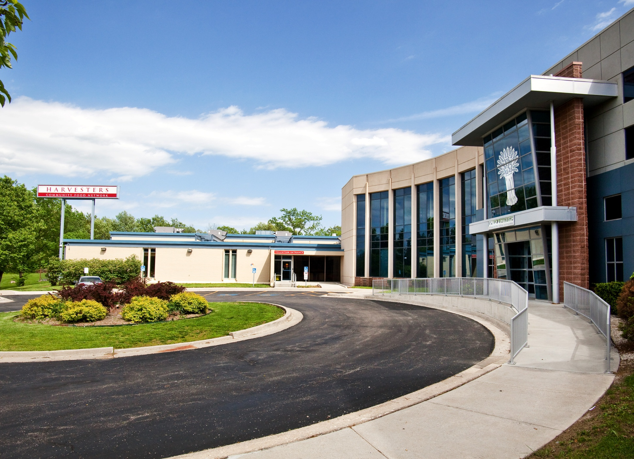
www.harvesters.org
Give Food Give Money
Give Time Give Voice
Notes:
Thank you for coming to Harvesters today, please visit our website for more ways you can be a part of the fight against hunger.
If in HAC, let them know there are informational sheets about Harvesters at the back of the room

Slide 23
The Harvesters Story
Harvesters’ mission is to feed hungry people today and work to end hunger tomorrow
We are a food bank serving 26 counties in northeast Kansas and northwest Missouri
Harvesters’ network of nonprofit agencies feeds 141,500 different people each month
Notes:
Harvesters is the Feeding Americas Food Bank for our region. Harvesters serves a 26 county area in NW Missouri (10 counties) and NE Kansas (16).
Feeding Americas is a nationwide network of more than 200 food banks. In 2011, Harvesters was Selected as Feeding Americas Food Bank of the year.
As a food bank, Harvesters acquires, stores and distributes food to its network of non-profit agencies, currently +760. These include food pantries, community kitchens, homeless shelters, children's’ home and others.

Slide 24
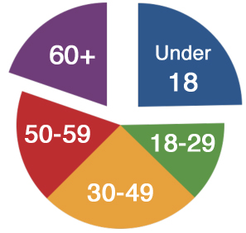
Who does Harvesters serve?
20%
Are
Seniors
25%
Are
Children

Slide 25
Who does Harvesters serve?
49% of households have at least one adult who worked in the last year
61% of households are living below the poverty line
47% receive SNAP benefits
51% of households have at least one member in fair or poor health
Only 5% of households are homeless

Slide 26
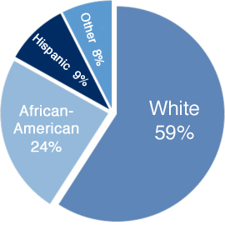
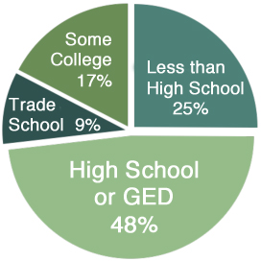
Who does Harvesters serve?
Race/Ethnicity
Education

